Slide 1







AUTOMATION
End-to-End Event Management Automation
TEAM NAME : CoreX
TEAM MEMBERS:
KARUNYA K A
ABINAYASRI K
INDIRANANDAN R
JAISHREE T

Slide 2


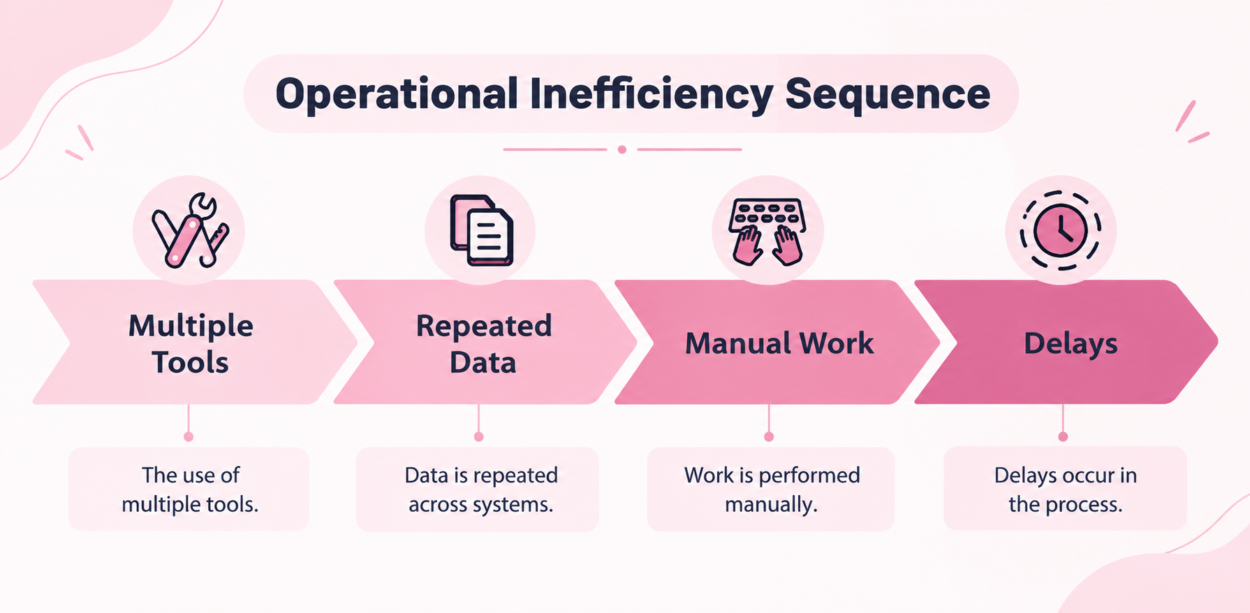
PROBLEM STATEMENT
In college events with 500+ participants, registration, attendance, certificates, and reports are often maintained separately.
This can lead to 20–30% repeated data entry, 5–10% duplicate or incorrect records, and significant delays in attendance verification and certificate preparation.
A connected system can reduce manual work, avoid duplicate entries, and provide faster, accurate event reporting.
30%
overall operational impact

Slide 3
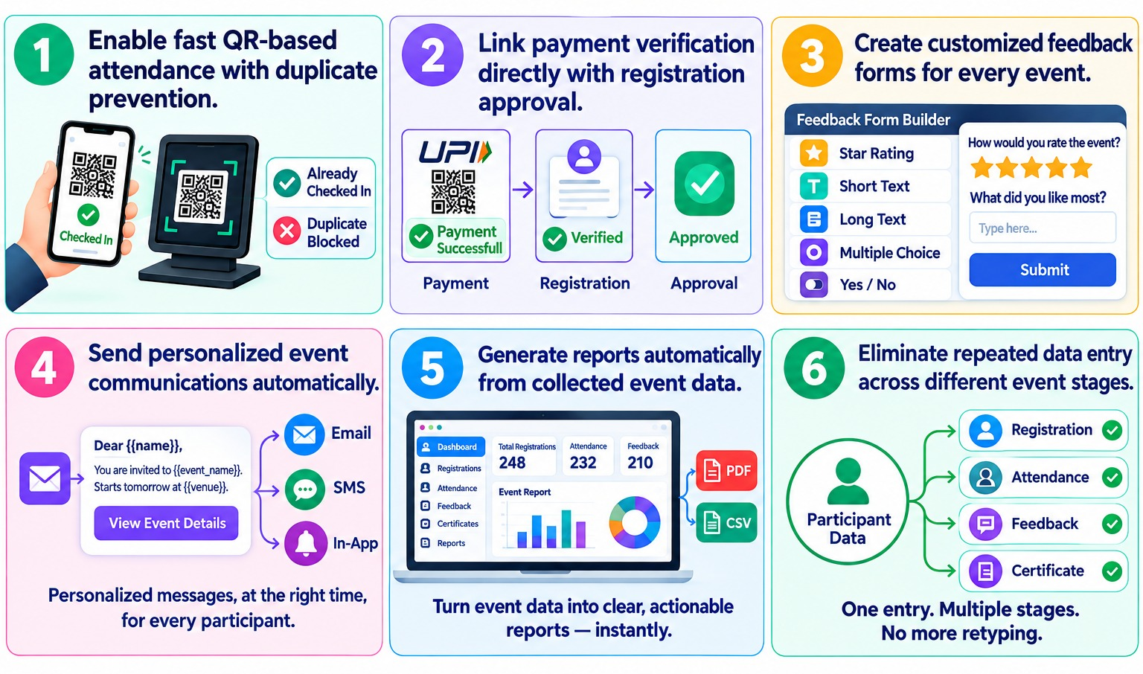
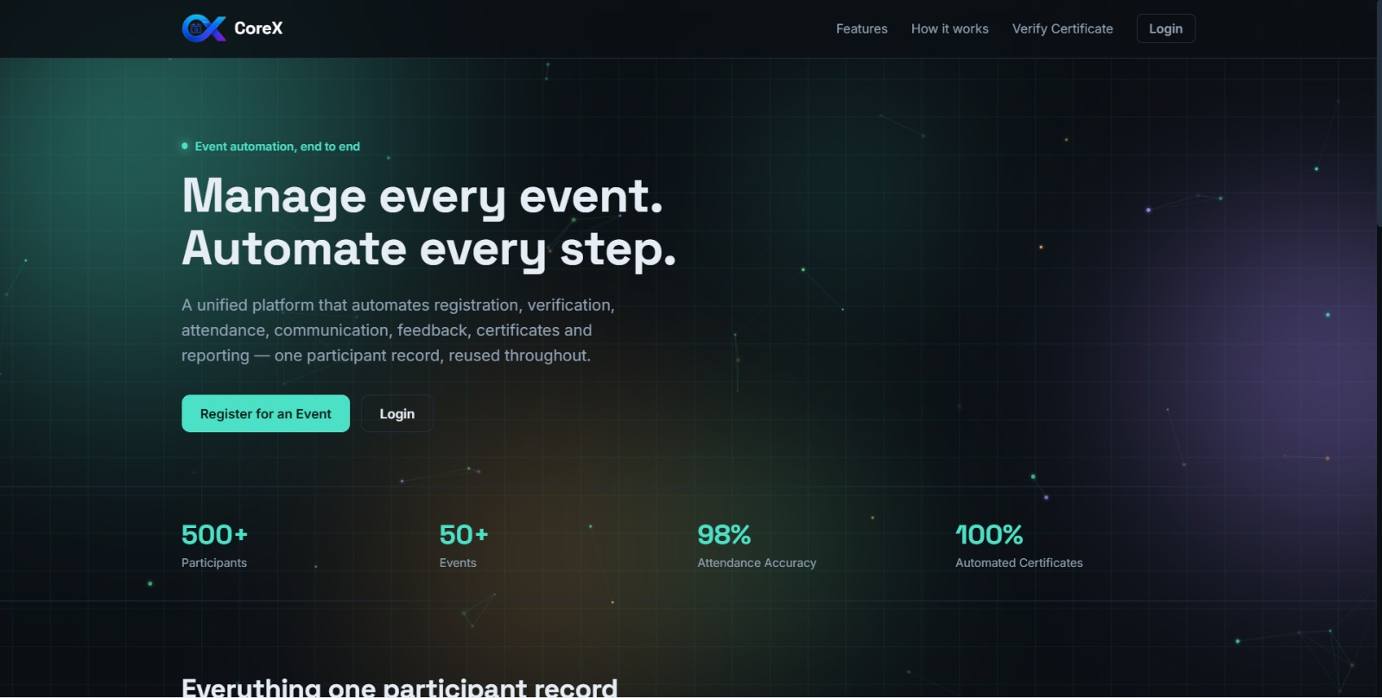


PROPOSED SOLUTION
UNIQUENESS
Centralized Event Management:
A single platform connects event creation, registration, verification, QR attendance, feedback, certificates, and reports using one participant record. This reduces repeated data entry and keeps all event information organized.
Automated Event Workflow:
The system automates participant verification, attendance tracking, notifications, feedback collection, certificate generation, and report preparation, making the complete event process faster and easier to manage.
GitHub
DEMO VIDEO LINK
https://indiranandan-r.github.io/Event_Portal/

Slide 4
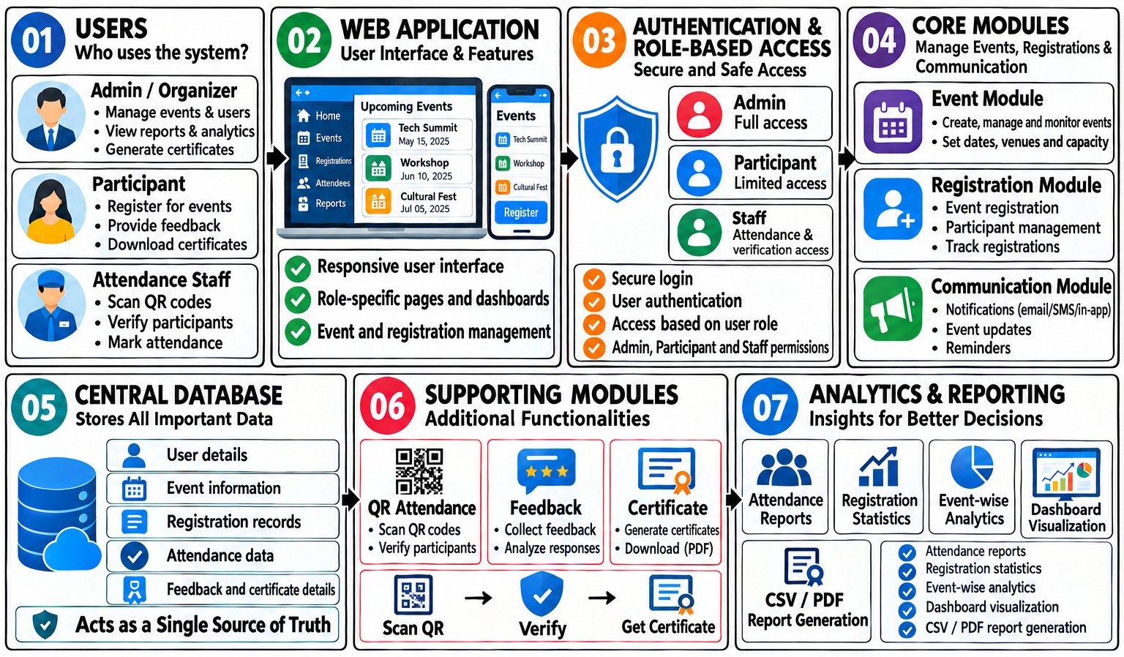
TECHNICAL APPROACH

Slide 5
FEASIBILITY
Can be developed using simple web technologies like HTML, CSS and JavaScript.
QR attendance, communication, certificates and reports can be handled within the same portal.
The current prototype already demonstrates the main workflow.
VIABILITY
Reduces repeated manual work for event organizers.
Participant details are entered once and reused throughout the event.
Can be useful for college events, workshops, seminars and competitions.
Can be expanded later with a proper backend and database.

Slide 6
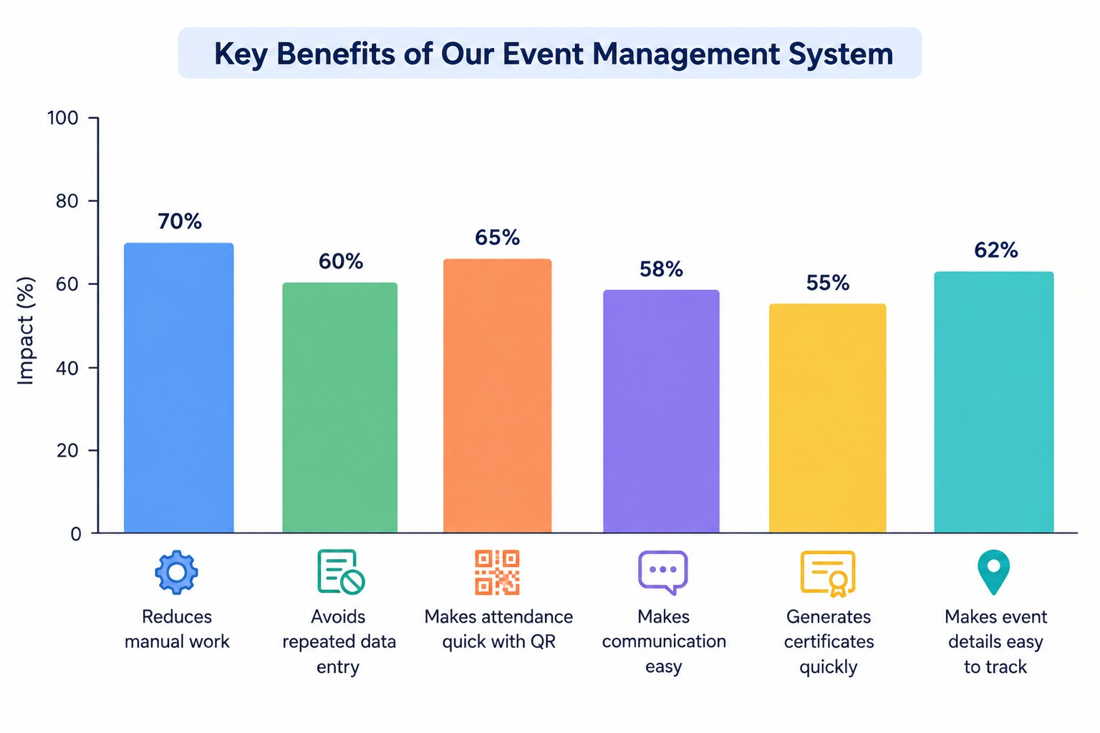
IMPACT & BENEFITS
Makes event management easy and organized
Reduces the workload of organizers
Makes the event process faster
Gives participants a better experience
Helps manage the complete event in one place
Reduces manual work
Avoids repeated data entry
Makes attendance quick with QR
Makes communication easy
Generates certificates quickly
Makes event details easy to track

Slide 7
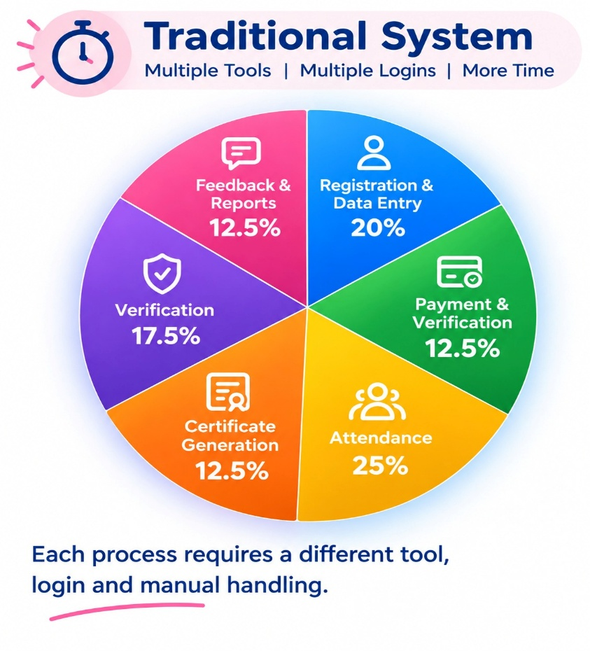
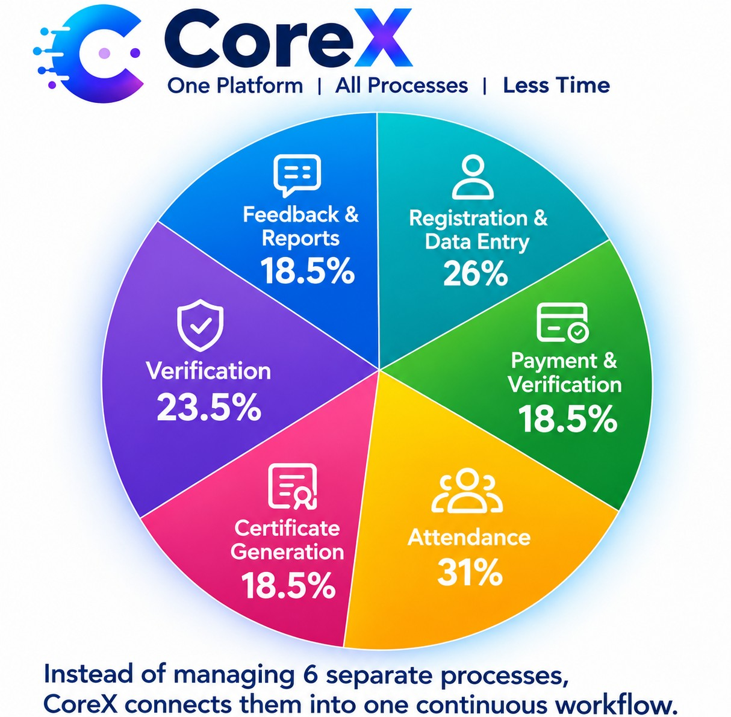
RESULT AND REFERENCE
LINK
Shara, C., & Sarala, V. (2025). Online Event Management System. International Journal of Management Research and Reviews, 15(2s), 330-332. | https://www.proquest.com/openview/5ae3507a7c9fa1998134f6ae87a5e45f/1?pq-origsite=gscholar&cbl=2028922
Bukhari, A. N. A., Adly, A., Haidzir, I. S., Nathan, S. S., & Saji, N. (2026). iConnect: A Web-Based Digital Platform for Integrated Management of Large-Scale Events. Emerging Advances in Integrated Technology, 7(1), 41-50 | https://journal.uthm.edu.my/index.php/emait/article/view/25181
Putra, N. A. E., & Darman, R. (2025). The Development of a Web Based UTHM Event Central Management System. Applied Information Technology And Computer Science, 6(2), 208-227. | https://periodical.uthm.edu.my/index.php/aitcs/article/view/20405
Golder, A., Nandi, S. K., Eva, A. A., Roy, A., & Ahammed, M. T. (2025, July). A novel framework for end-to-end encrypted peer-to-peer communication. In 2025 International Conference on Quantum Photonics, Artificial Intelligence, and Networking (QPAIN) (pp. 1-6). IEEE. | https://www.proquest.com/openview/5ae3507a7c9fa1998134f6ae87a5e45f/1?pq-origsite=gscholar&cbl=2028922
REFERENCE

Slide 8
THANK YOU

